Slide 1




Bulls & Bears
Akshay Navaneetha Krishnan, Dinesh Bandaru, Bhuvana Chandrika Kothapalli, Ashwanth Draksha, Jahnavi Angati

Slide 2


Problem Statement
Background: The stock market is a complex and dynamic financial system where investors seek to maximize returns while managing risks. Making informed investment decisions in the stock market relies on the analysis of historical and real-time data, as well as the ability to anticipate future trends. To facilitate these decisions, a predictive stock market analysis system is essential.
Problem Statement: The project aims to combine historical stock prices for market behavior insights with sentiment analysis for investor sentiment, ultimately providing predictive stock market analysis to empower informed investment decisions and portfolio management.

Slide 3

Why it matters?
Improved Decision-Making: Informed investors can make data-driven decisions based on historical market behavior and current sentiment, leading to more successful investment strategies.
Event Analysis: This approach can also provide insights into which events or factors are contributing to stock price movements.
Risk Management: Understanding market behavior and investor sentiment allows for better risk assessment and mitigation, reducing the potential for significant financial losses.

Slide 4

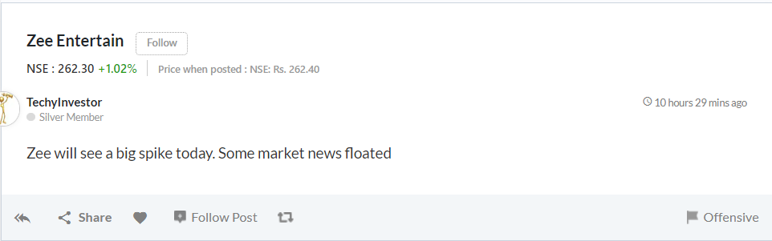
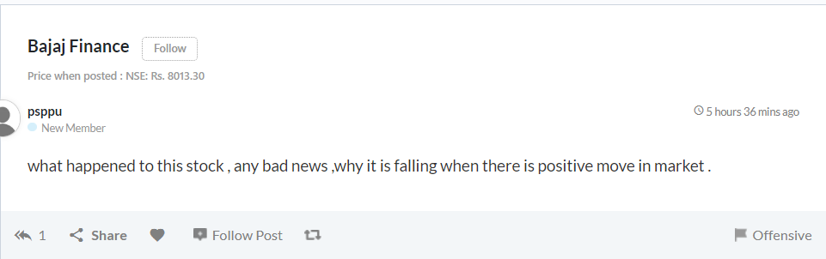
Raw Data
Data Source
Stocks Discussion Forum
Notes:
Add one more ss

Slide 5
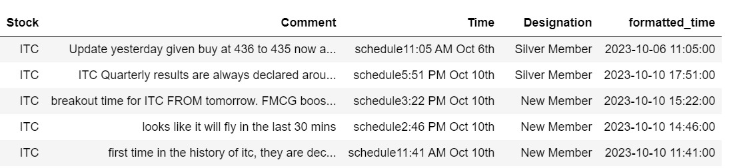

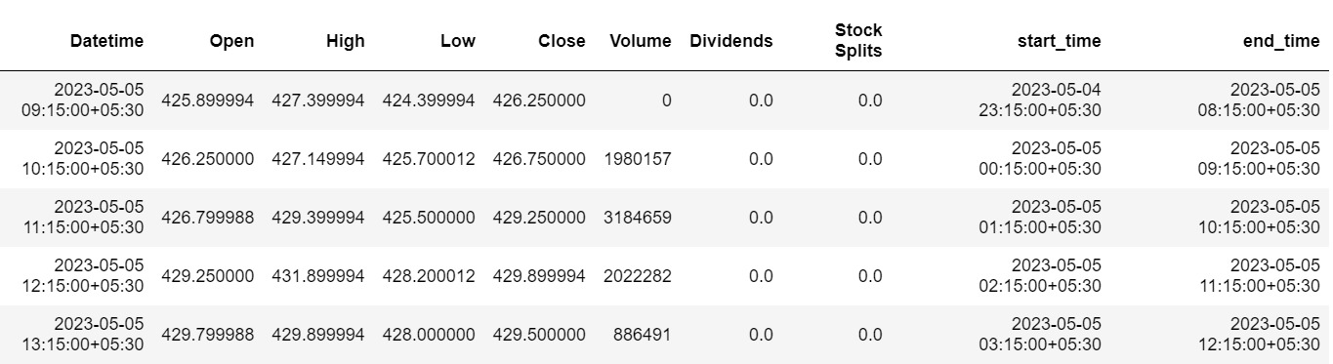

Slide 6
Roadmap
Topic Modeling
Sentiment Analysis
to categorize and organize large sets of textual data, making it easier to find, understand, and utilize information effectively
Buy/sell
Modeling
Value Stocks
to gain insights, make predictions, and understand their behavior more comprehensively
Picking unknown stock

Slide 7

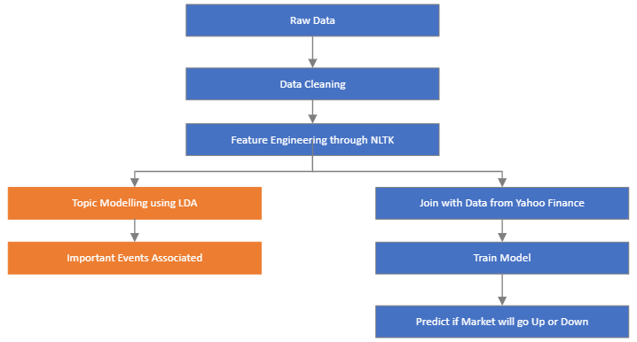
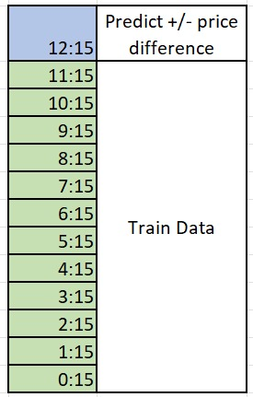
Analysis

Slide 8
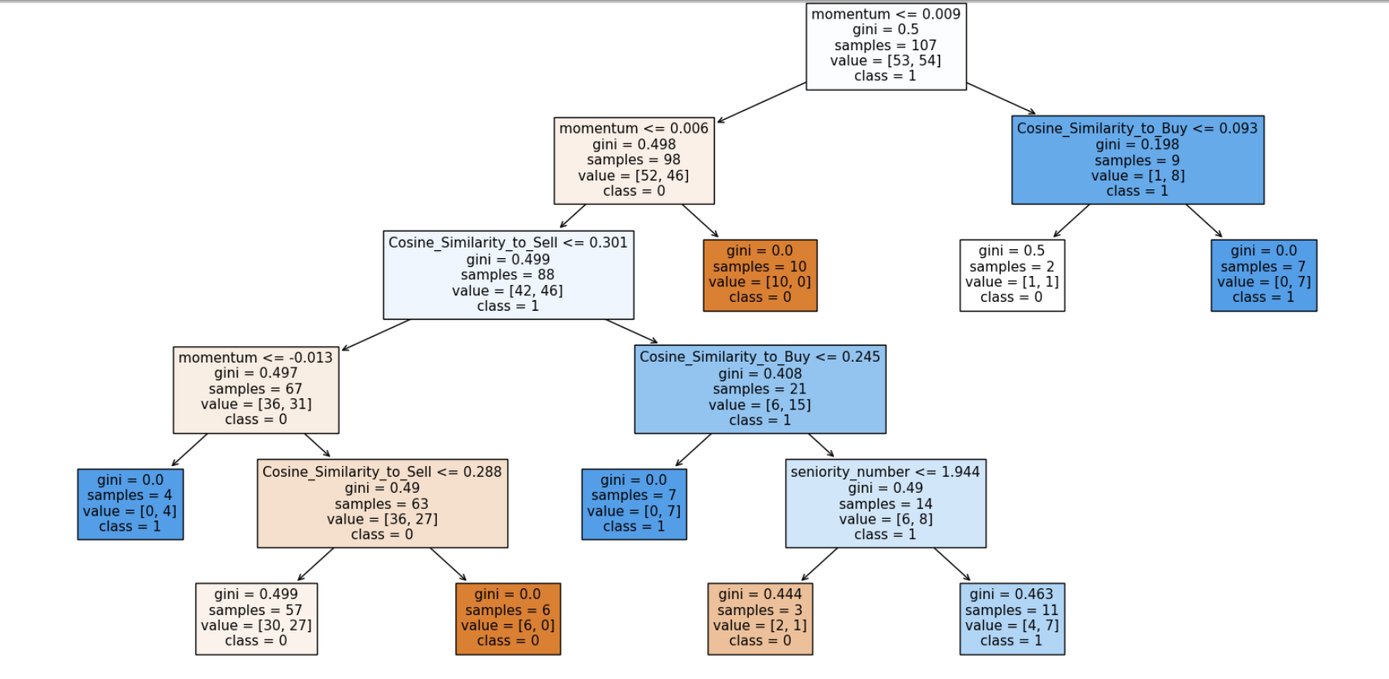
Important Features

Slide 9









Topic Modeling

Slide 10

Insights and Recommendations
Better Predictions
Able to make 5% better predictions than baseline.
 | Baseline Accuracy | Accuracy
Zomato | 0.52 | 0.60
Bajaj Finance | 0.56 | 0.57
ITC | 0.51 | 0.53
Event Analysis
Successfully found important events driving price.
Value Stocks
Discovered high performing stocks with low visibility.

Slide 11

Thank You!
Q&A

Slide 12
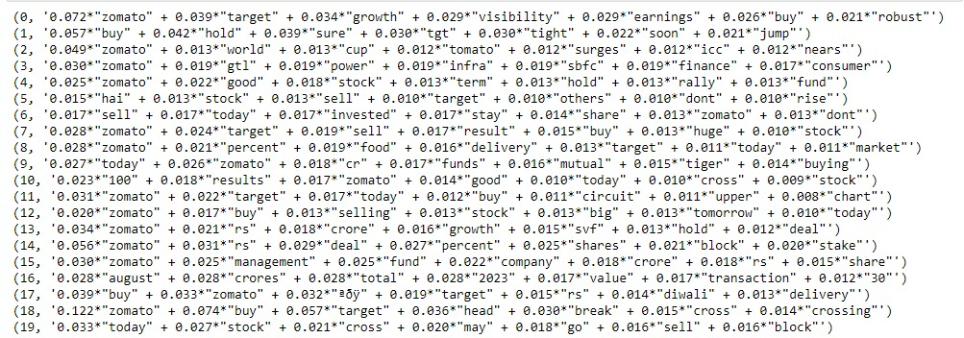
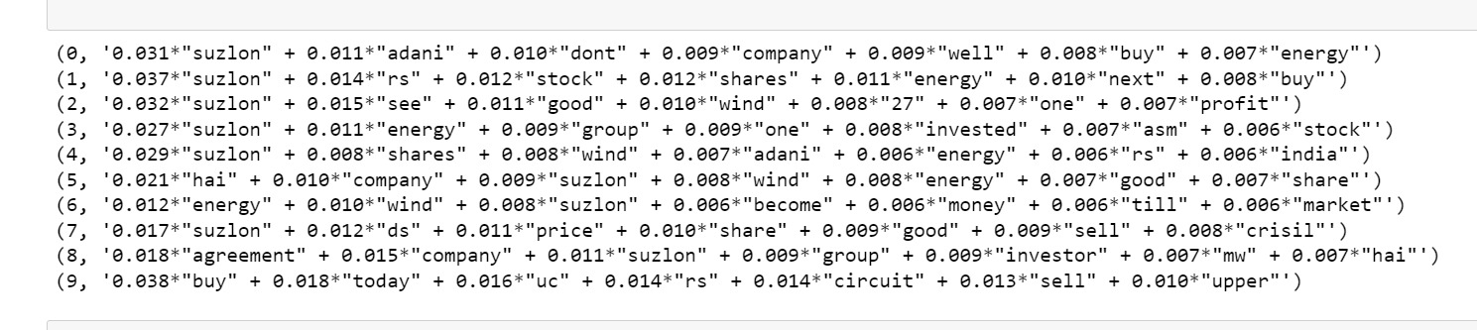
Appendix: Topic Modeling Results

